Slide 1


Social Buzz

Slide 2


Content:
Project Recap
Problem
The Analytics Team
Process
Insights
Summary

Slide 3

The Project is ‘Social Buzz’ . Social Buzz emphasizes content by keeping all users anonymous, only tracking user reactions on every piece of content. The Client requires an audit of their big data practice, recommendations for a successful IPO, an analysis of their content categories that highlights the top 5 categories with the largest aggregate popularity.
Project Recap

Slide 4

Problem
Over the past 5 years, Social Buzz has reached over 500 million active users each month. They have scaled quicker than anticipated and need the help of an advisory firm to oversee their scaling process effectively. Due to their rapid growth and digital nature of their core product, the amount of data that they create, collect and must analyze is huge. Every day over 100,000 pieces of content, ranging from text, images, videos and GIFs are posted. All of this data is highly unstructured and requires extremely sophisticated and expensive technology to manage and maintain. Out of the 250 people working at Social Buzz, 200 of them are technical staff working on maintaining this highly complex technology.

Slide 5



Managing Director
Mae Mulligan
The Analytics team
Senior Industry Analyst
Tim Pike
Data Scientist
Michelle Grove

Slide 6
Process
1
Project Understanding
2
Data Cleaning and Modeling
3
Data Visualization
4
Story Telling
5
Present to the Client

Slide 7
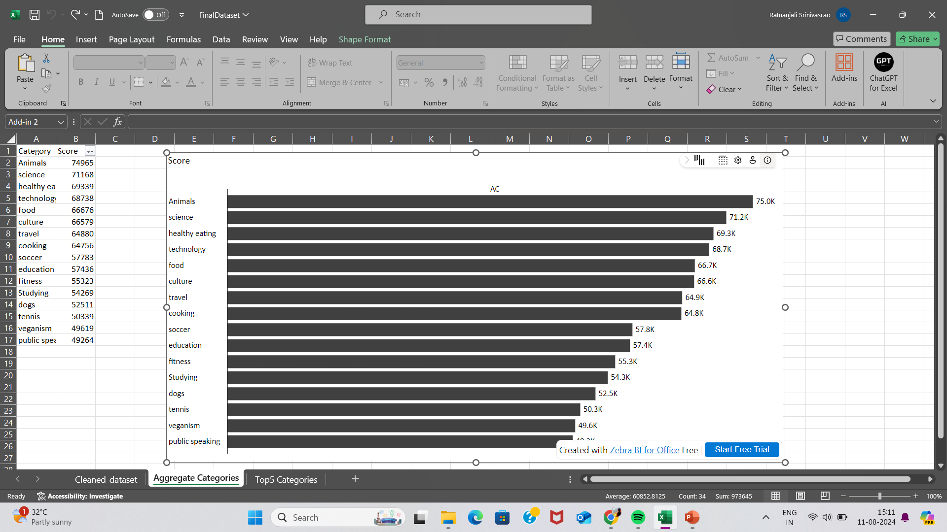

Insights:
This Insight shows the total score of all categories.

Slide 8
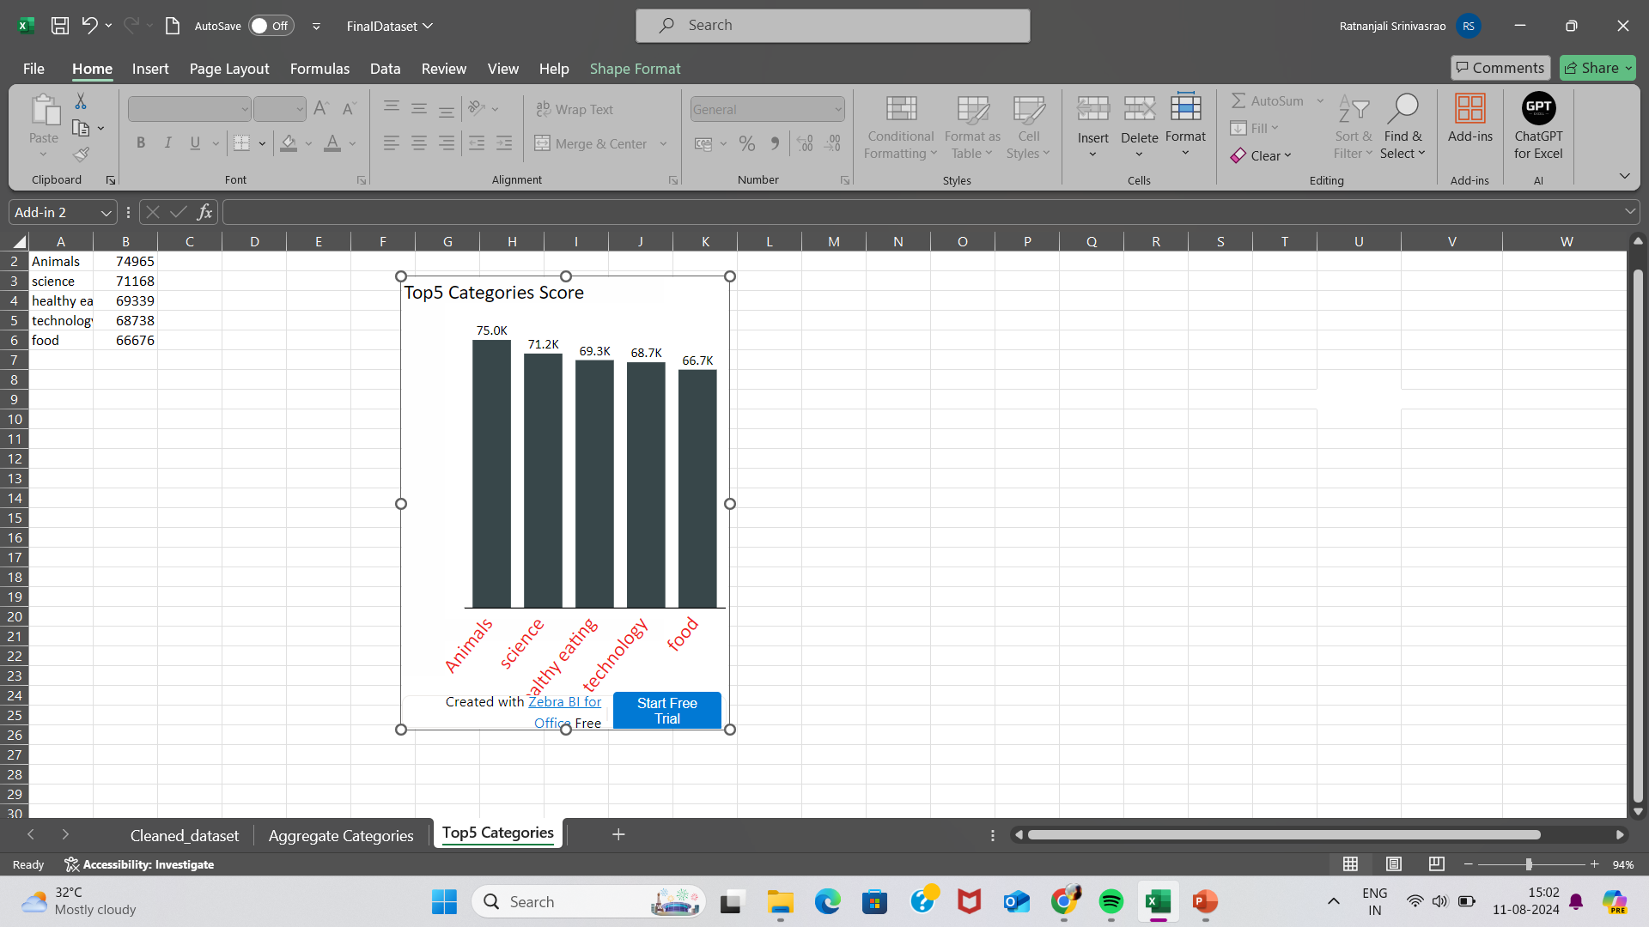
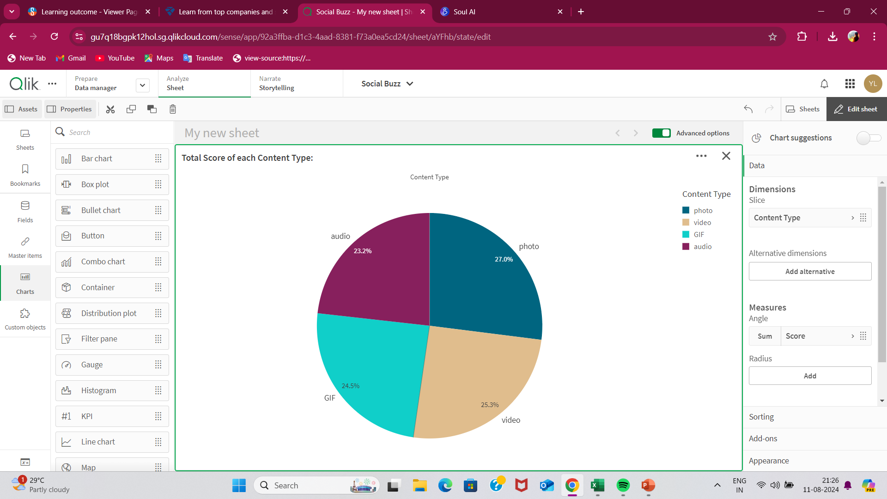

Slide 9
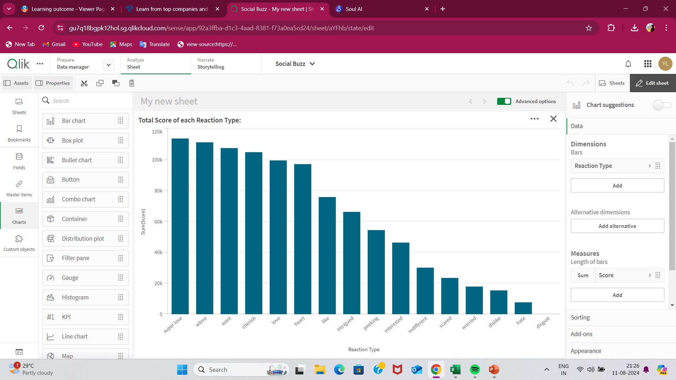
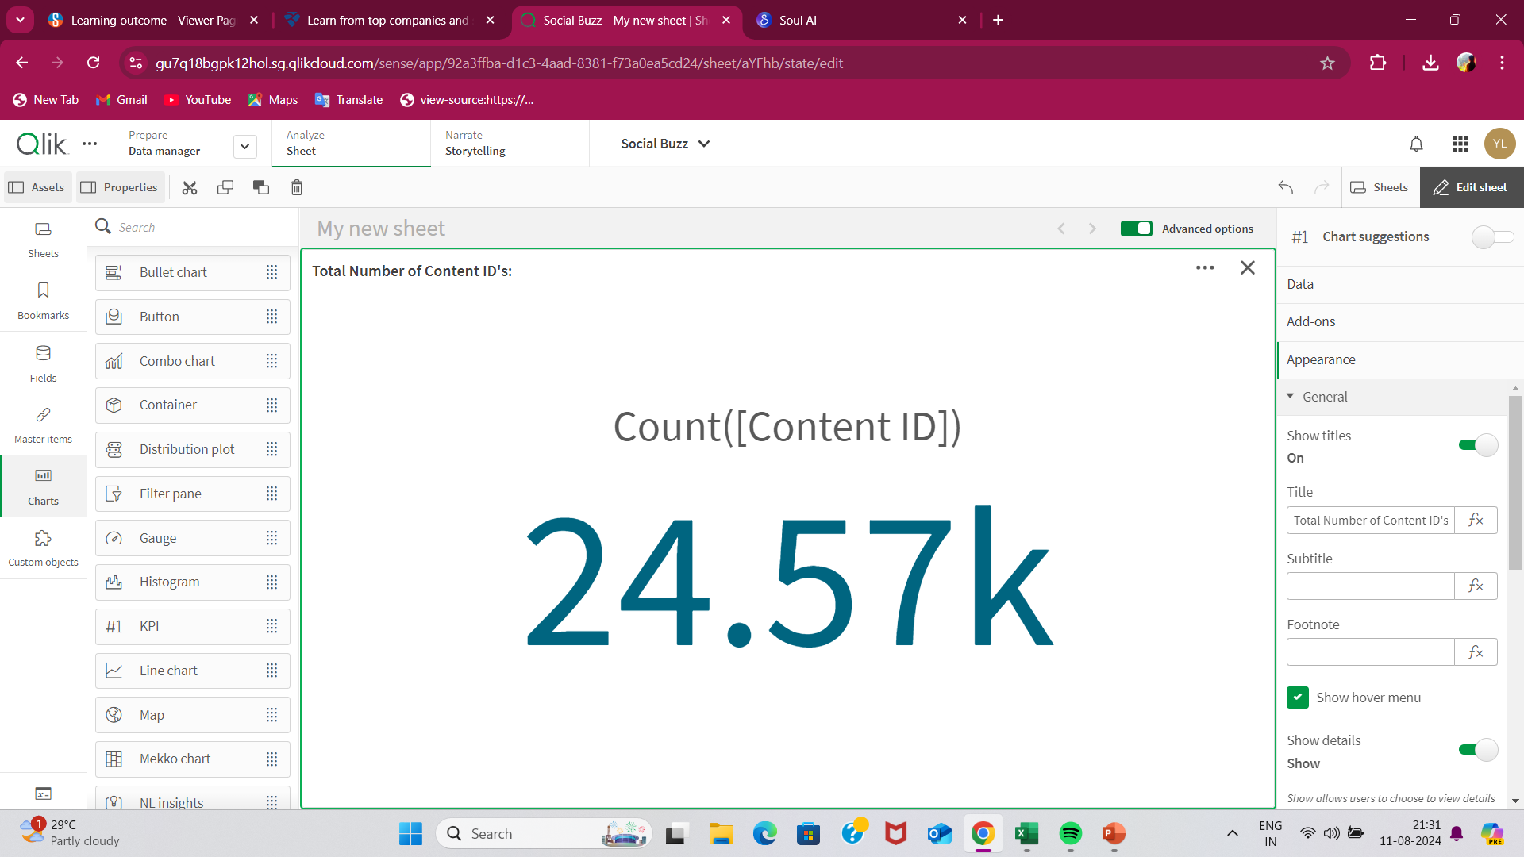

Slide 10

The entire analysis is done in four steps which is requirement gathering, data cleaning, data modelling, data visualization and story telling.
The Top5 Categories are analysed from large data sets which are animals, science, food, technology, healthy eating.
Animals and Science are the two most popular categories of the content.
Summary

Slide 11
Thank you!
ANY QUESTIONS?

